Slide 1
Connect web services to Microsoft Teams with webhooks & Office 365 Connectors

Slide 2
Integrate existing services with Microsoft Teams using webhooks and connectors
Outgoing webhooks
How to add outgoing webhooks to Microsoft Teams

Slide 3
Webhooks & connectors in Microsoft Teams

Slide 4
Integrate existing services with Microsoft Teams
Webhooks & Connectors enable connecting web services to Microsoft Teams
Simple extensibility option
Respond to messages when @mentioned (outgoing webhooks)
Send proactive messages to configured channels (incoming webhooks & Connectors)

Slide 5
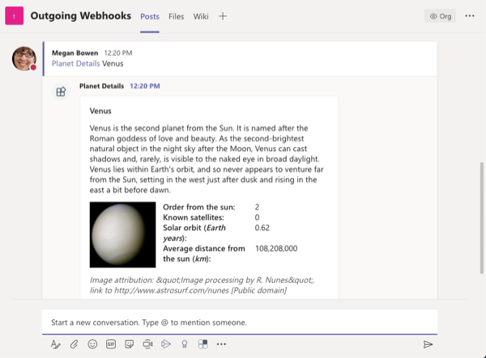
Process channel messages with outgoing webhooks
Messages that include @mentioned registered outgoing web hook sent to the web service’s endpoint
Service must respond within 5 seconds
Responses are added to the reply chain of the initiating message
Web service can respond with a text-based message or a card
Configured on a per-team basis

Slide 6
Send channel messages with incoming webhooks and Office 365 Connectors
Send proactive messages with incoming webhooks & Office 365 Connectors
Incoming webhooks are similar to outgoing webhooks: register on a per-channel basis
Once registered, external web service submits HTTP post to the provided endpoint
Developers must configure web service with the incoming webhook endpoint
Office 365 Connectors are like incoming webhooks, except:
Can be included in Microsoft Teams app
Include a configuration page that can send the webhook endpoint to the web service
Can be published for your entire organization to add via “More Apps” experience, or to AppSource

Slide 7
Outgoing webhooks

Slide 8
Outgoing webhooks & Microsoft Teams
Conceptually work the same way as bots except you don’t have to register them with the Microsoft Bot Framework
Key features:
Scoped configuration: scoped on a team-by-team basis
Reactive messaging: must be @mentioned
Standard HTTP message exchange: responses appear in same reply chain as original message
Limited Microsoft Teams API message support: messages sent to web service, but don’t have access to APIs like list of channels or the channel roster in a team

Slide 9
Add outgoing webhooks to Microsoft Teams

Slide 10
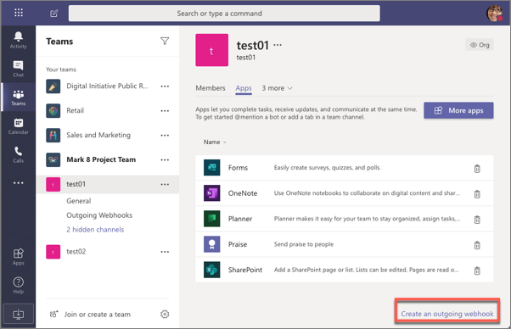
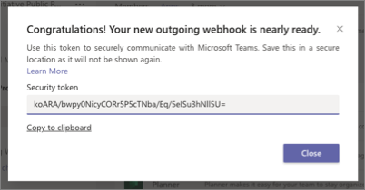
Add outgoing webhooks to Microsoft Teams
Create web service that accepts HTTP POST requests with a JSON payload
Ensure web service validates the message using the provided security token & HMAC auth string
Register outgoing webhook with Microsoft Teams team

Slide 11
Authenticating messages from Microsoft Teams
After registering an outgoing webhook, Microsoft Teams displays a security token
Each message sent to your web service includes an HMAC in the HTTP request authorization header
Use the security token to create a HMAC in your web service
Verify your HMAC code matches the one include in the message received from Microsoft Teams

Slide 12
DEMO
Create outgoing webhooks

Slide 13
Incoming Webhooks
How to add incoming webhooks to Microsoft Teams
Sending Messages to channels with incoming webhooks

Slide 14
Overview incoming webhooks

Slide 15
Incoming webhooks & Microsoft Teams
Incoming webhooks are a special type of Connector
Provide simple way for external apps to share content & team channels
Microsoft Teams provide unique URL for a channel that your web service can post to
Key features:
Scoped configuration: scoped & configured at the channel level
Secure resource definition: messages included as JSON payloads; prevents malicious code injection
Actionable messaging support: send messages as text-based messages or rich cards
Independent HTTPs messaging support: present clear & consistent messages with cards
Markdown support: support for rich formatting of text

Slide 16
Add incoming webhooks to Microsoft Teams

Slide 17
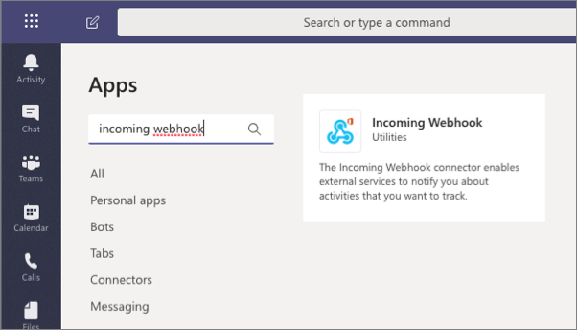
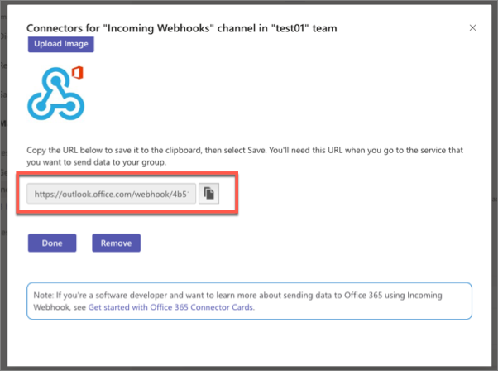
Add incoming webhooks to Microsoft Teams channels
Create web service that can send HTTP POST requests to an HTTPS endpoint
Add the Incoming webhook app to a channel & configure it – copy the provided endpoint

Slide 18
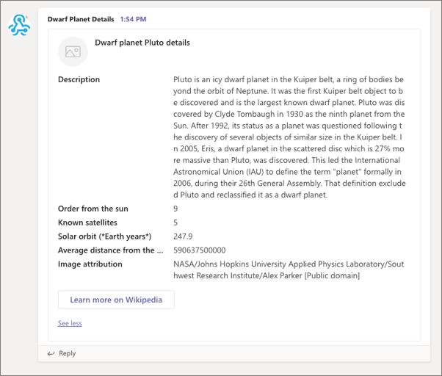
Incoming webhook messages in Microsoft Teams
Your web service sends HTTP POST request with a JSON payload to the provided endpoint
Messages are added to the Conversations tab in the configured channel

Slide 19
DEMO
Create incoming webhooks

Slide 20
Office 365 Connectors overview
Add Connectors to Microsoft Teams

Slide 21
Office 365 Connectors

Slide 22
Office 365 Connectors
Office 365 Connectors are like incoming webhooks except the install & configuration experience is slightly simpler
Connectors have the same capabilities as incoming webhooks
Connectors differ from incoming webhooks in the following ways:
Inclusion in AppSource: once validated by Microsoft, can be included in AppSource for broad distribution
Publish to your organization: publish to your organization’s App Store to enable the entire organization to use it
Custom configuration experience: when adding to a channel, custom configuration screen is displayed that enables collection of Connector-specific configuration details

Slide 23
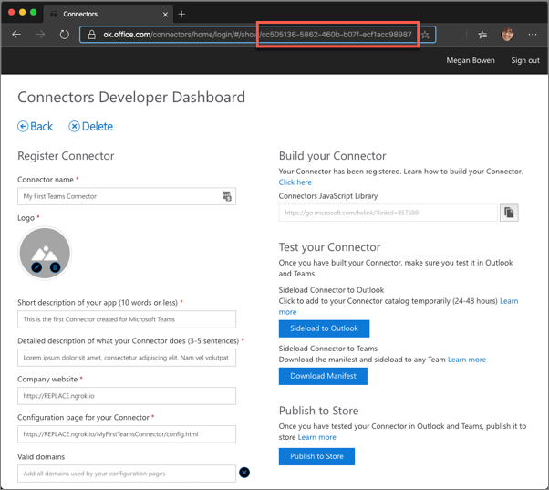
Add an Office 365 Connector to a Microsoft Teams app
Connectors are distributed to Microsoft Teams in the custom Teams app manifest
All Connectors must first be registered in the Connectors Developer Dashboard
Once registered, retrieve the ID of the Connector for inclusion in the Teams app manifest

Slide 24
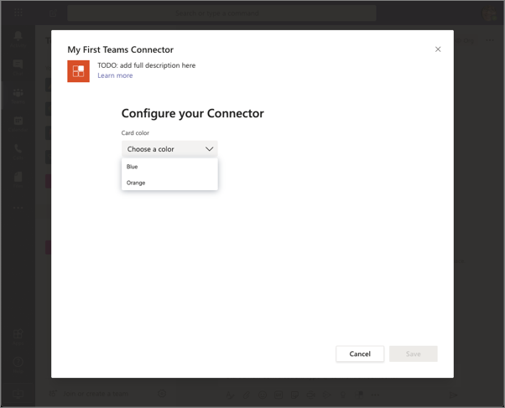
Create the configuration experience
When a Connector is added to a channel, Microsoft Teams displays a configuration page within an IFRAME
Enables Connector developers to collect Connector-specific configuration data
When the user selects Save, the configuration page submits the request to the web service
Can include the webhook endpoint Microsoft Teams creates for the Connector

Slide 25
Configuration page specifics
Developers implementing the configuration experience should do the following:
Include the Microsoft Teams JavaScript SDK
Call microsoftTeams.settings.setValidityState(true) when the form is valid
Implement the microsoftTeams.settings.registerOnSaveHander()
Call microsoftTeams.settings.getSettings()
Optionally implement the microsoftTeams.settings.registerOnRemoveHandler()

Slide 26
Add the Connector to the Microsoft Teams app manifest
{
"manifestVersion": "1.13",
"id": "5f6df040-493b-11ea-897f-1b87e48d60c9",
"version": "0.0.1",
"packageName": "myfirstteamsconnector",
"connectors": [
{
"connectorId": "{{CONNECTOR_ID}}",
"configurationUrl": "https://{{HOSTNAME}}/myFirstTeamsConnector/config.html",
"scopes": ["team"]
}
]
}

Slide 27
DEMO
Create and add Office 365 Connectors to teams

